Slide 1
Presentation 02
“Modeling Environment/Agent”
Sep xx, 2022

Slide 2
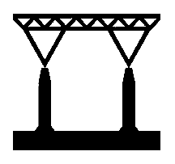
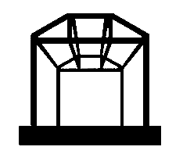
1. Structure: expectations
Has initial cost of built
Probability of working decreases over time
Based on probability of working at each step, it may stop working
It can be renovated

Slide 3
1. Structure: example
Probability = 1 - (coeff * (dt_years ** degree))

Slide 4
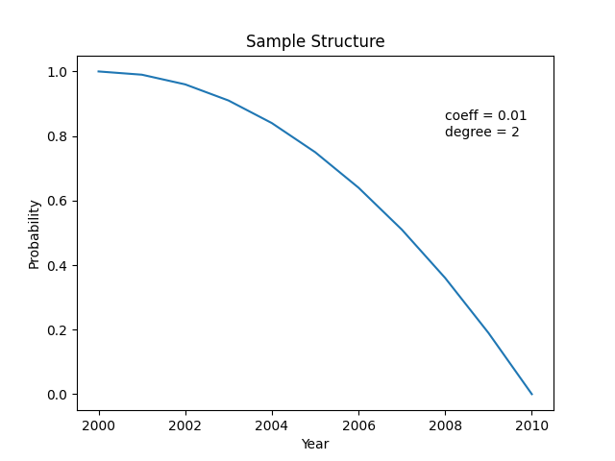
1. Structure: example
Probability = 1 - (coeff * (dt_years ** degree))

Slide 5
1. Structure: example

Slide 6
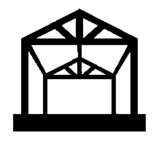

2. Infrastructure
Is a type of Structure
They have start and end points, and connect settlements (e.g. cities)
They are in charge of handling certain recourses
Definition of other equipment is needed for certain types of infrastructure to be able to transfer resources (e.g. vehicle)

Slide 7
3. Settlement
Is a type of Structure
They have start and end points, and connect settlements (e.g. cities)
They are in charge of handling certain recourses
Definition of other equipment is needed for certain types of infrastructure to be able to transfer resources (e.g. vehicle)

Slide 8
4. Agents
They produce/use/store certain resources
They make decisions to optimize their goals (economy is emergent)
They can choose to move to destination (vehicle, on foot, etc.)
If deficiency for a resources reaches the threshold, agent dies.

Slide 9
4. Agents
The agents contain 4 nodes for each resource:
1. Produce
2. Use
3. Deficiency
4. Storage

Slide 10
4. Agents: graph representation

Slide 11
4. Agents: edges
Storage
Use
Deficiency
Produce
In the graph, each edge represents a possible transaction.
The goal of the agents is to find the best ones and accomplish them.
The starting node has a source, and the ending node will have a demand
source
demand
starting node
ending node

Slide 12
4. Agents
Storage
Use
Deficiency
Produce
For each resource, an agent:
1. Produce: production rate
2. Use: use rate

Slide 13
4. Agents
Storage
Use
Deficiency
Produce
For each resource, an agent:
3. Deficiency: at each step, if “use” is not satisfied, accumulates as deficiency. If it reaches “deficiency_max”, agent dies.
properties:
- deficiency_current
- deficiency_max
If it reaches “deficiency_max”, the agent dies.
Only acts as a ending point, with demand value of “deficiency_current”

Slide 14
4. Agents
Storage
Use
Deficiency
Produce
For each resource, an agent:
4. Storage: storage unit
properties:
- storage_current
- storage_max
Acts both as a starting point and ending point, with values of:
demand = storage_max - storage_current
source = storage_current

Slide 15
Thank you for your patience

